Slide 1
SKYTRAX AIRLINE REVIEW ANALYSIS

Slide 2
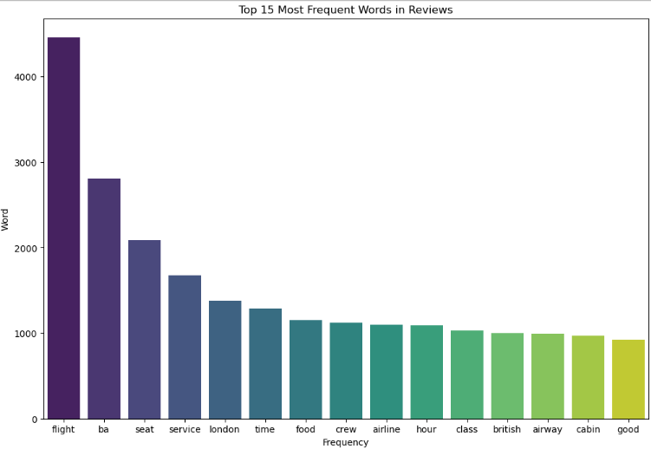
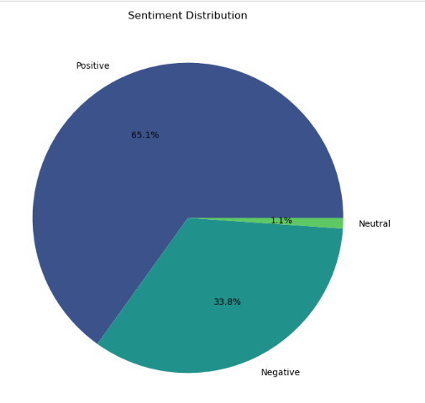
RESULTS
Key Topics Sentiment
The frequency chart below shows that the key topics within Out of 2000 reviews 1302 were positive, 676 was
the reviews include “service”, “seat”, “crew” and “staff” showing negative and 22 were neutral. This means majority of
that people are actively talking about their experience and staff. of reviews were polarised as Negative or Positive.

